Slide 1

To Implement Wind speed tracking
NAME: MADHUMITHA.B
SUB: OOSE
ROLLNO:48
SUBCODE:21IT204T
REGNO:113222072055
Objective / Scope (2) | Plan of Execution (2) | Implementation (2) | Presentation (2) | Insight on project area (2) | Total (10)

Slide 2
Module Details
Objective & Scope
Problem Statement
Plan of Execution
Module 1
Module 2
Module 3
Conclusion
Reference

Slide 3
Objective
The primary objective of a Wind Speed Tracker is to provide accurate, real-time data on wind speed and direction to support various applications, such as:
Weather Monitoring: Enhance meteorological accuracy for forecasting and research.
Aviation Safety: Assist pilots in flight planning and operations, especially during takeoff and landing.
Marine Navigation: Aid in the safety of maritime operations by providing crucial wind data for navigation.
Renewable Energy Management: Optimize wind turbine operations and assess site viability for wind energy projects.
Environmental Studies: Support research in ecology and climate science by monitoring wind patterns and their effects.

Slide 4
scope
Scope of Wind Speed Tracker
Data Collection: Utilize anemometers and other sensors to gather wind speed and direction data from various geographical locations.
Data Analysis: Implement algorithms to process and analyze the collected data, identifying trends and anomalies.
User Interface: Develop an intuitive user interface (web/mobile) for users to access real-time data, historical records, and forecasts.
Integration: Enable integration with other meteorological systems and platforms, including APIs for third-party applications.
Alert System: Establish a notification system to alert users about significant changes in wind conditions that may affect safety and operations.
Reporting: Generate comprehensive reports and visualizations for various stakeholders, including researchers, engineers, and emergency services.
Field Testing: Conduct field tests in different environments to ensure the reliability and accuracy of the tracking system.

Slide 5
Problem Statement
TO IMPLEMENT A WIND SPEED TRACKER
Implementing a Wind Speed Tracker using HTML, CSS, and JavaScript involves several steps, including data collection, processing, and visualization. Below is a simple algorithm outline for creating such a tracker, along with an example implementation.
ALGORITHM FOR WIND SPEED TRACKING WEBSITE
Define Requirements
Set Up the Environment
Design the User Interface
Fetch Wind Data
Process the Data
Update the User Interface
Add Visualization (Optional)
Test the Application
Deploy the Website
Monitor and Maintain

Slide 6
Plan of Execution
Phase 1: Planning and Research
Define Objectives
Identify primary goals (e.g., provide real-time wind data, user-friendly interface).
Research APIs
Evaluate and select a weather API that provides wind data (e.g., OpenWeatherMap, WeatherAPI).
Review documentation for API usage limits and features.
Identify User Needs
Conduct surveys or interviews with potential users to understand their requirements.
Phase 2: Design
Wireframing
Create wireframes or mockups of the user interface using tools like Figma or Sketch.
Outline the layout, including sections for wind speed, direction, and visualizations.
Style Guide
Choose color schemes, fonts, and design elements to ensure consistency.
Phase 3: Development Setup
Environment Setup
Set up a code editor (e.g., Visual Studio Code).
Initialize a version control system (e.g., Git) and create a repository.
Create Project Structure
1. Organize your project folder( eg. Index.html,myscript.js,mystyle.css)

Slide 7
Plan of execution
Phase 4: Implementation
HTML Development
Build the basic structure of the webpage using HTML.
Include sections for displaying wind data.
CSS Styling
Apply styles to the HTML elements for a polished look.
Ensure responsiveness with media queries.
JavaScript Functionality
Implement data fetching using the selected weather API.
Parse the response and update the UI with wind data.
Set up an interval to refresh data periodically.
Visualization (Optional)
Integrate a charting library to visualize historical wind data.
Set up charts to display trends over time.
Error Handling
Implement error handling for API requests and display user-friendly messages.
Phase 5: Testing
Functional Testing
Test all features to ensure they work as expected (data fetching, UI updates).
Check responsiveness on various devices (desktop, tablet, mobile).
Cross-Browser Testing
Ensure compatibility across major browsers (Chrome, Firefox, Safari).
User Testing
Gather feedback from users to identify areas for improvement.

Slide 8
Plan of execution
Phase 6: Deployment
Choose a Hosting Service
Select a hosting platform (e.g., GitHub Pages, Netlify) based on your needs.
Deploy the Website
Upload files to the hosting service and configure settings as needed.
Test Live Version
Verify that the live version functions correctly and data is updating.
Phase 7: Maintenance and Updates
Monitor Performance
Keep an eye on API usage limits and website performance.
Collect User Feedback
Implement feedback mechanisms to gather user insights for future improvements.
Plan Updates
Schedule regular updates to the website based on user feedback and API changes.

Slide 9
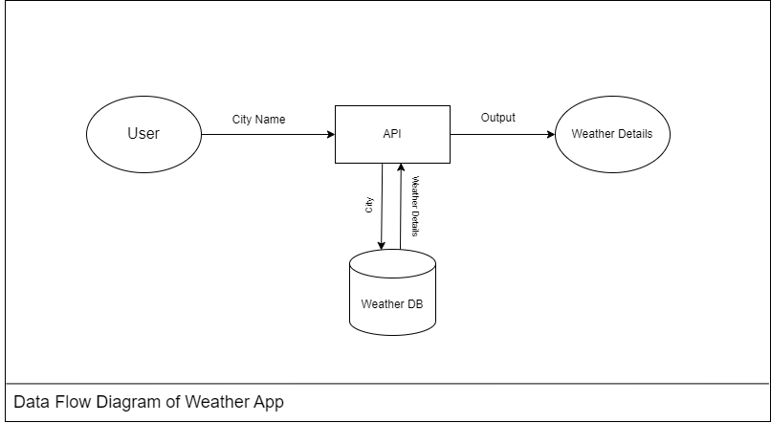
Module 1 implementation/output
DATA FLOW DIAGRAM

Slide 10
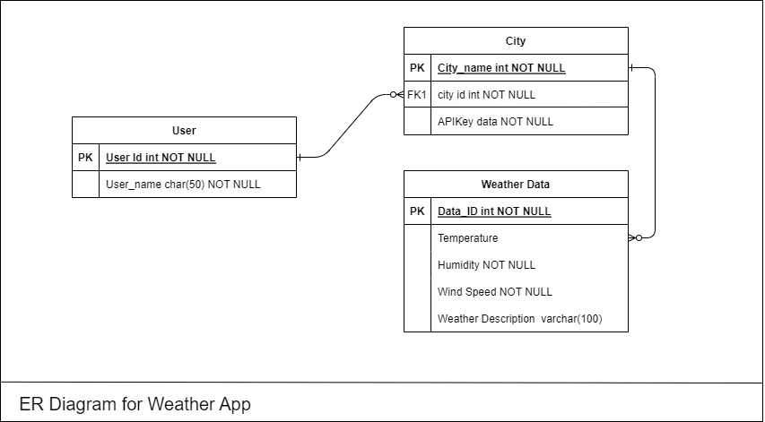
Module 1 output
ER DIAGRAM

Slide 11
Module 2
In module one going to create simple html page with enhancing css application for 2 website
Create the Weather App UI Structure using the HTML elements like <div>, <h1>, <input> and <button>. Embed all the essential CDN links for Icons, Fonts, etc.
Once the structure is created, the styling properties for each element like padding, box-shadow, transition, attractive effects like hovering, etc are been applied.
In the main JavaScript file, the overall behavior of the application is been defined.
Firstly, we are specifying the API URL of OpenWeatherMap. Then we are specifying the unique API key. By defaul,t the Weather of the Pune location is been shown when the application is loaded.
Then by using the async function, we are returning the wwather of the city which is entered by the user. If the city is not valid, then an error message is been shown to the user.
Once the details are fetched, then these details are been represented in the weatherShowFn().

Slide 12
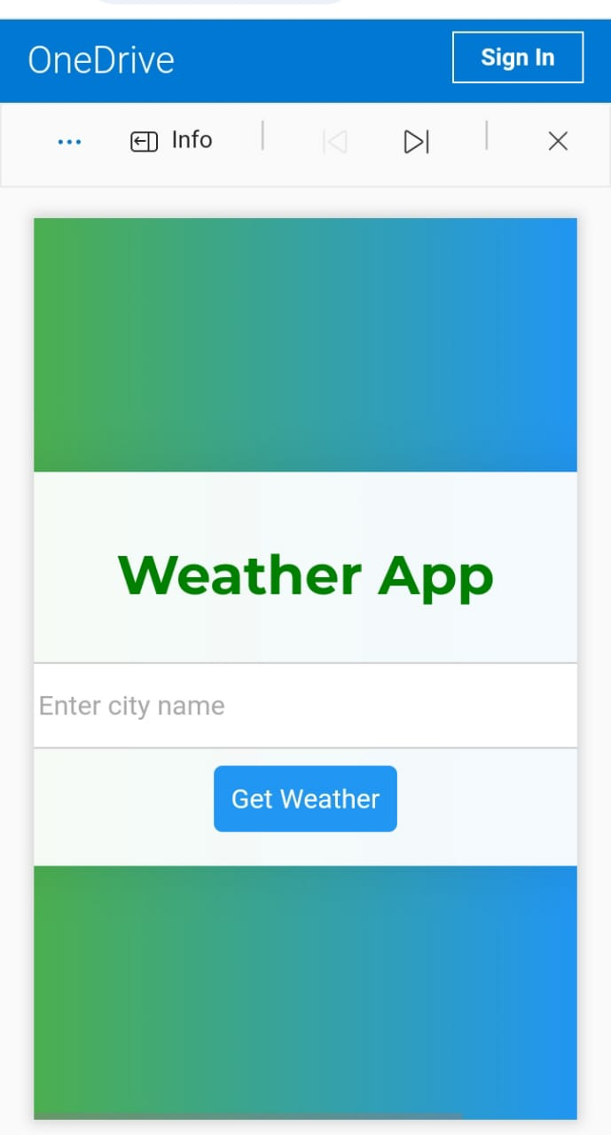
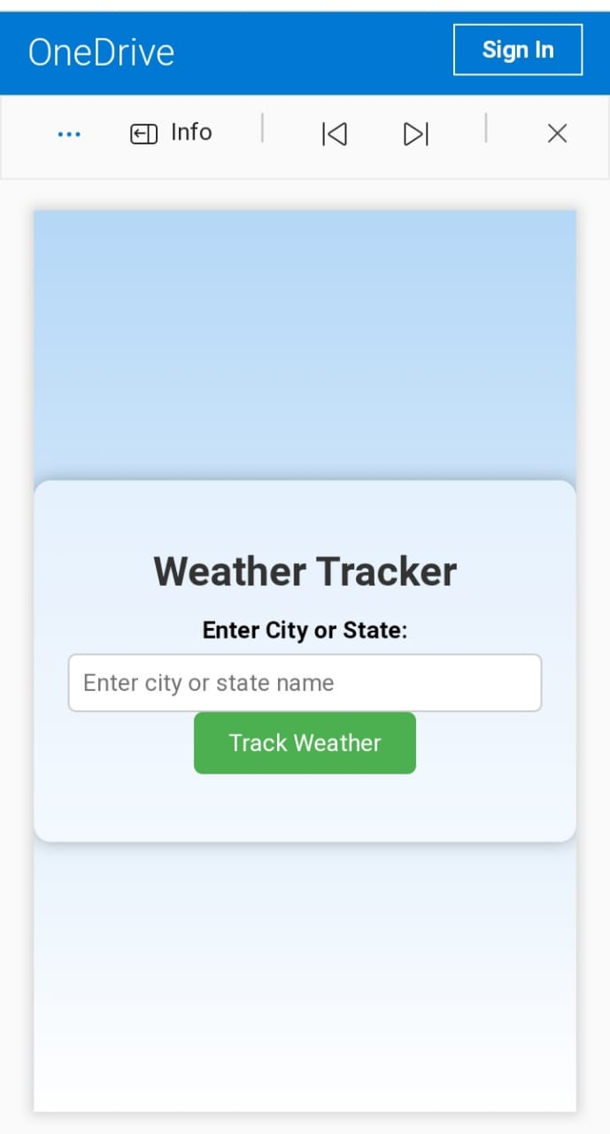
Module 2 implementation/output
1st website page
2nd website page

Slide 13
Module 3
The entire 2 different website is created for tracking wind speed but it also provide other weathercasting details.
Functionalities of this page:
User can put the City name and get the weather details:
Temperature
Humidity
Wind Speed
Weather Description
Easy User Interface
The final module involves creating the front-end of your application using HTML, CSS, and JavaScript. This is where users can interact with the wind speed tracker. Design an intuitive interface that displays real-time wind speed, historical data, and visualizations. Consider adding features like user alerts for specific wind conditions, search functionality for different locations, and a responsive design for mobile users.

Slide 14
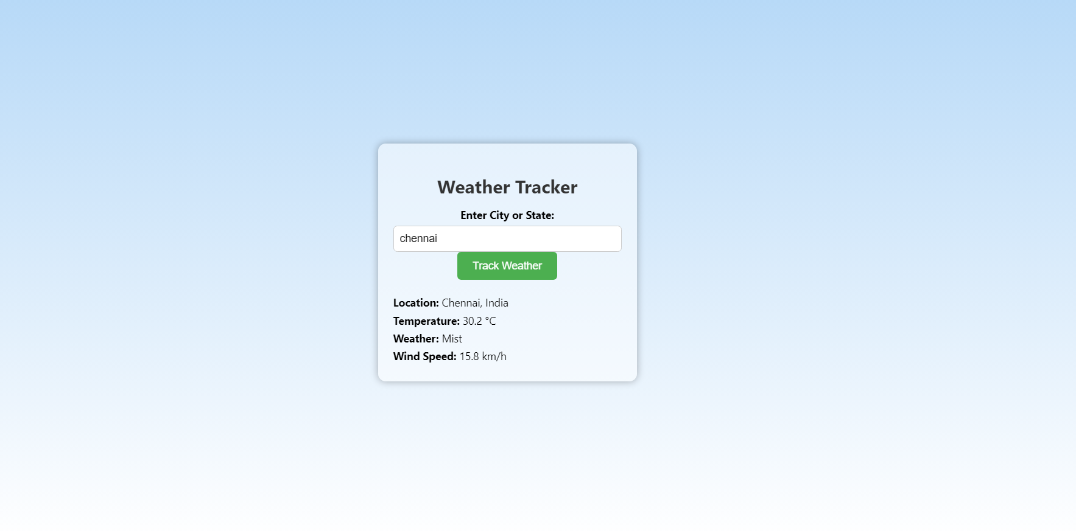
Module 3 output
The entire output for 1 st website.

Slide 15
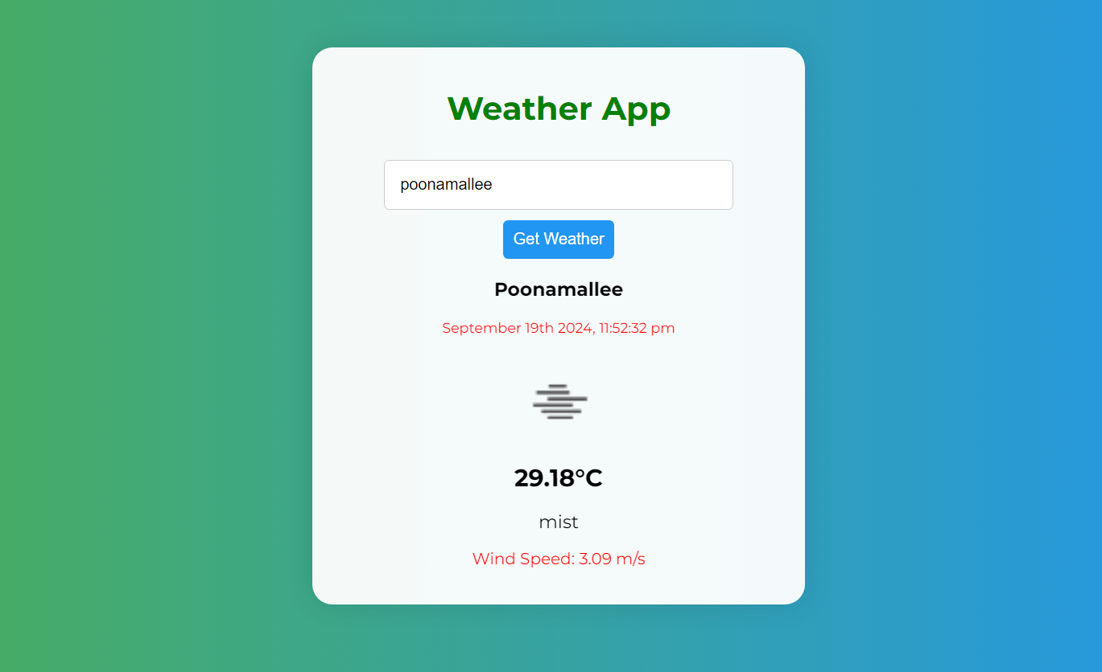
Module 3 output
The entire output for second website.

Slide 16
Conclusion
The weather application you’ve built is a comprehensive example of how to create an interactive web app using HTML, CSS, and JavaScript. By integrating external libraries like jQuery for easier DOM manipulation and Moment.js for date formatting, you’ve enhanced the functionality and user experience of the app.
Key Features:
User Input: Users can enter a city name to fetch real-time weather data.
Dynamic Display: The app updates the weather information dynamically based on user input, showcasing temperature, weather description, wind speed, and an icon representing the weather conditions.
Responsive Design: The CSS styles ensure that the app is visually appealing and maintains usability across various devices.
Error Handling: The application includes basic error handling to inform users when a city cannot be found.
Future Enhancements:
API Key Security: Consider implementing server-side logic to keep your API key secure.
Additional Features: You could expand the app to include forecasts, additional weather metrics, or location-based services.
Accessibility Improvements: Enhance accessibility features to make the app usable for all individuals.
Styling Improvements: Continue refining the CSS for a more polished and modern look.

Slide 17
Reference
Link for my own website 1
https://1drv.ms/f/c/dd8a0b9fadfad057/EuTZoIYDXUlJkNSKaGr1sisBTCe8RZEcGsgRXUliyCeoug?e=Ac9qAN.
Link for my own website 2
https://1drv.ms/f/c/dd8a0b9fadfad057/Egox9EBkFrRPtV47K8h_pDcBJMsURa9lsjbCA_qhGCXRZw?e=4zV8Xv.

